Slide 1
Resume Screening System
Automated candidate ranking using NLP and Machine Learning

Slide 2
Problem Statement
Recruiters receive many resumes. The system automatically ranks candidates for a job role.

Slide 3
Technologies Used
Python, Scikit-Learn, TF-IDF, Cosine Similarity, PyPDF2, Google Colab

Slide 4
Methodology
Resume Parsing → Text Processing → Skill Matching → Candidate Ranking

Slide 5
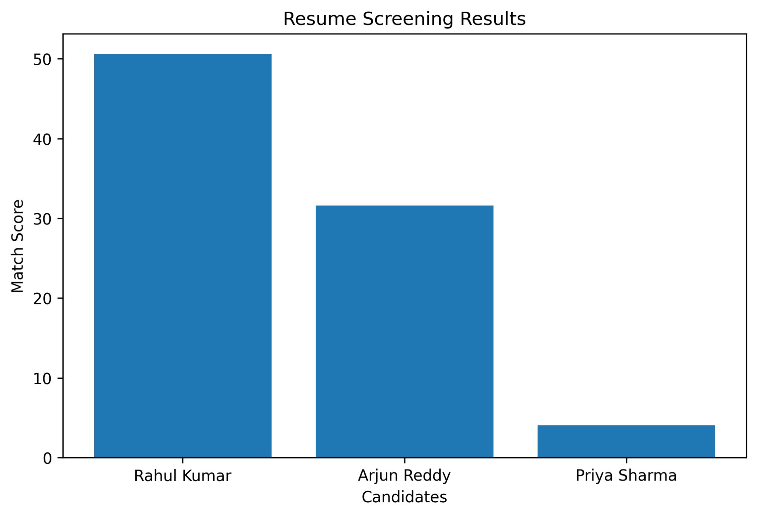
Results
Candidate ranking graph generated by the system.

Slide 6
Conclusion
The system helps recruiters quickly identify the best candidates.

